Slide 1
Methodocracy Foundation
Scientific
Makes
Nonprofit Organization
Educational
methodocracy.org

Slide 2
Only 1 Management Team
Member Thus Far
Founder, Chairman, CEO:
Zachary Hebert
Born March 1994
Tested 99.9th percentile intelligence
Highly motivated individual wanting to improve the world as much as possible before his death.

Slide 3
Academia has a huge money problem
It's very hard to be a young scientist
Too many studies are poorly designed
The academic community is broken
Science is often poorly communicated to the public
Scientists rarely replicate experimental results
Scientific journal paywalls make reading results expensive
Peer review doesn't work the way it's supposed to

Slide 4
Something like methodocracy.org doesn’t exist

Slide 5
Connecting research together into the larger debate.
Involving the general population.
Solution
Hosting bill drafting for public policy and proposal drafting for the private sector.

Slide 6
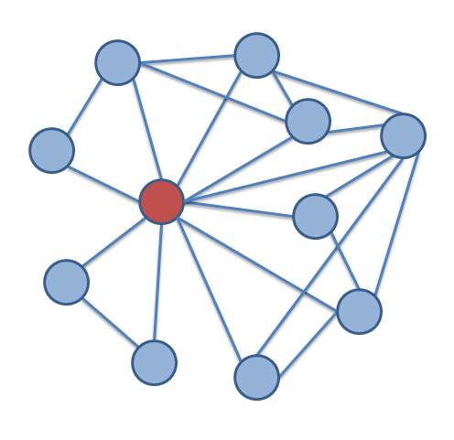
Product:
Users enter entries into the knowledge base and form connections between other entries. AI helps.
#1
#2
Note: The red dot does not signify anything

Slide 7
Target audience is attendees of academic conferences
So
Market is almost every academic conference

